Slide 1
TE Mini Project on PCOS Detection System
By
Tejas Desai - 657
Aaditya Shinde - 676
Vaishnavi Mishra - 667
Manas Pimple - 670
Project Guide
Prof. ANUSHREE DESHMUKH
Department of Information Technology

Slide 2
CONTENTS OF THE PRESENTATION
Abstract
Problem statement
Introduction
Objectives
Scope
Literature Survey
Algorithms Used
Methodology
Flowchart
References

Slide 3
ABSTRACT
Polycystic Ovary Syndrome or PCOS is an endocrine disorder that occurs in women of reproductive age. The condition once detected cannot be cured but treatment can help relieve its effects. The exact cause of PCOS is still unknown but there are certain factors that portray the risk of getting PCOS. The factors that result in this syndrome are: obesity, insulin resistance, blood pressure, depression, inflammation. While the symptoms include: acne, heavy bleeding, skin darkening.The machine learning models used for supervised classification are Random Forest,Support Vector Classifier,Decision Tree, and Logistic Regression. The reason behind building multiple models is to find out the best one for the given dataset, in the known scope of knowledge

Slide 4
PROBLEM STATEMENT
The aim of this project is to develop a PCOS detection system that can accurately identify women at risk of developing the condition. The system should be able to analyze a range of factors, including medical history, physical symptoms, and blood test results, to provide a comprehensive diagnosis. The development of a PCOS detection system has the potential to improve the lives of millions of women around the world by enabling early detection and intervention.

Slide 5
INTRODUCTION
Polycystic ovary syndrome (PCOS) is a common hormonal disorder that can be difficult to diagnose due to the wide range of symptoms and lack of a single definitive test. Automated PCOS detection systems that use machine learning algorithms to analyze medical data can provide clinicians with a reliable and objective tool for making a PCOS diagnosis. This technology has the potential to improve the diagnosis and management of PCOS, leading to earlier detection and more effective treatment for affected women.

Slide 6
OBJECTIVES
Early Detection: The system should be able to identify PCOS in patients at an early stage, when symptoms may not be severe or visible, to prevent long-term health consequences.
Accurate Diagnosis: The system should accurately diagnose PCOS based on patient data, including symptoms, medical history, and lab tests, to prevent misdiagnosis and ensure appropriate treatment.
Time and Cost Efficiency: The system should be able to analyze patient data quickly and efficiently, reducing the time and cost of diagnosis and treatment.
Interpretability: The system should be able to provide interpretable results, explaining the rationale behind its diagnosis and treatment recommendations to healthcare providers and patients.

Slide 7
METHODOLOGY
Data Collection: A large dataset of medical data, including blood tests, ultrasound results, and clinical symptoms, is collected from women with and without PCOS.
Feature Selection: Relevant features are selected from the dataset to help differentiate between PCOS and non-PCOS cases.
Data Preprocessing: The data is preprocessed to ensure that it is in a format that can be used by machine learning algorithms. This can involve steps such as normalization and feature scaling.
Model Selection: Commonly used algorithms include logistic regression, decision trees, and support vector machines.
Training and Validation: The selected machine learning algorithm is trained on a portion of the dataset and then validated on a separate portion to ensure that it can accurately identify PCOS cases.
Deployment: Once the model is validated, it can be deployed as a PCOS detection system that takes in new medical data and provides an objective diagnosis of PCOS.

Slide 8
ALGORITHM USED
Random Forest Classifier: It is a machine learning algorithm that uses an ensemble of decision trees to make predictions.
Decision Tree: Decision Tree is a machine learning algorithm used for both classification and regression tasks
Support vector classifier : (SVC) is a popular machine learning algorithm used for classification tasks.
Logistic Regression : Logistic Regression is a popular machine learning algorithm used for classification tasks.

Slide 9
ACCURACY TABLE
 | Random Forest | Decision Tree | System support Vector | Logistic Regression
How Different Attributes affect PCOS | 77% | 76% | 77% | 85%
Physical Symptoms affect PCOS | 61% | 62% | 64% | 63%
Hormones Affect PCOS | 64% | 57% | 70% | 70%
Breathing Affect PCOS | 64% | 57% | 64% | 63%

Slide 10
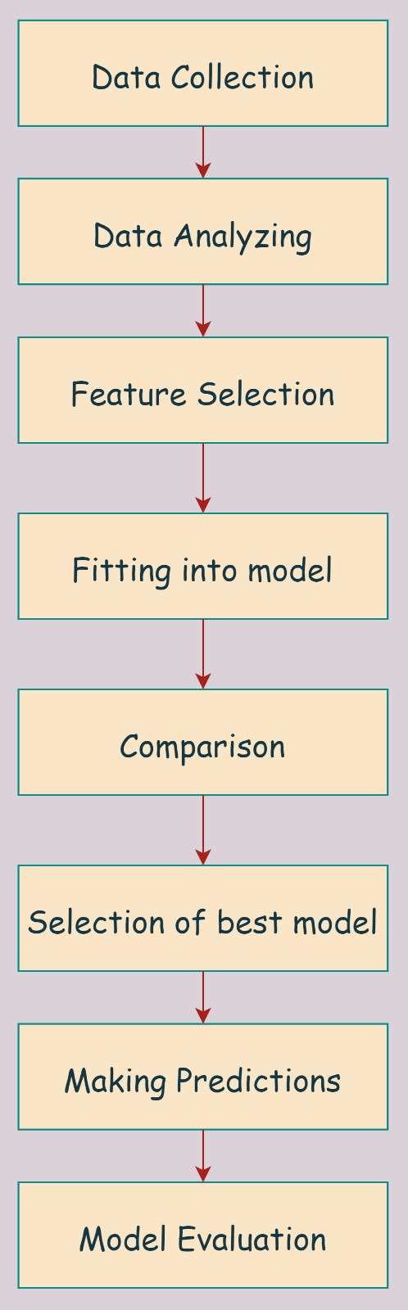
WORKFLOW

Slide 11
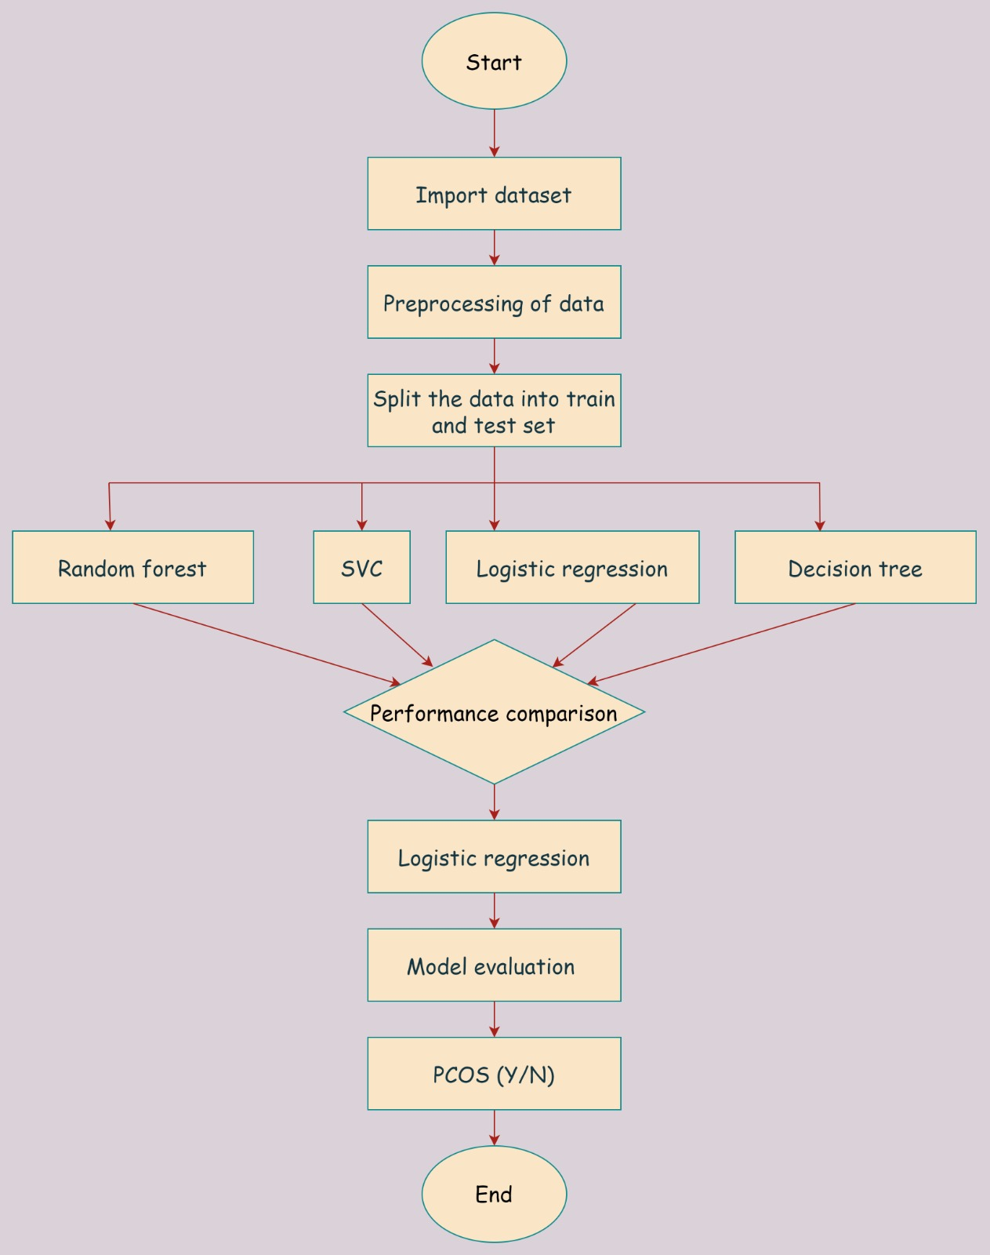
SYSTEMFLOW

Slide 12
REFERENCES
[1]. "Polycystic ovary syndrome diagnosis using machine learning techniques: A systematic review and meta-analysis" by F. Tasnim et al. (2021)
[2]. "Polycystic ovary syndrome detection through machine learning techniques: A review and a proposal" by L. A. Rubio-Sánchez et al. (2021)
[3]. A. Denny, A. Raj, A. Ashok, C. M. Ram and R. George, “i-HOPE: Detection And Prediction System For Polycystic Ovary Syndrome (PCOS) Using Machine Learning Techniques,” TENCON 2019 - 2019 IEEE Region 10 Conference (TENCON), Kochi, India, 2019, pp. 673-678.
[4]. A. S. Laganà, S.G. Vitale, M. Noventa, and A. Vitagliano, “Current Management of Polycystic Ovary Syndrome: From Bench to Bedside”, International Journal of Endocrinology, 2018. doi: 10.1155/2018/7234543

Slide 13
THANK YOU!

